Slide 1
DBMS UNIT 2 IMPORTANT QUESTIONS & ANSWERS

Slide 2
What is a relational database query? Explain with an example.
A relational database is a collection of information that organizes data in predefined relationships where data is stored in one or more tables (or "relations") of columns and rows.
Examples of RDBMS includes IBM, Oracle, MySQL, Microsoft SQLServer and PostgreSQL.
A query in a database is a request for information from a database management system (DBMS), which is the software program that maintains data.
Example query: Write any query based on joins, retrieve the information from one or more tables.

Slide 3
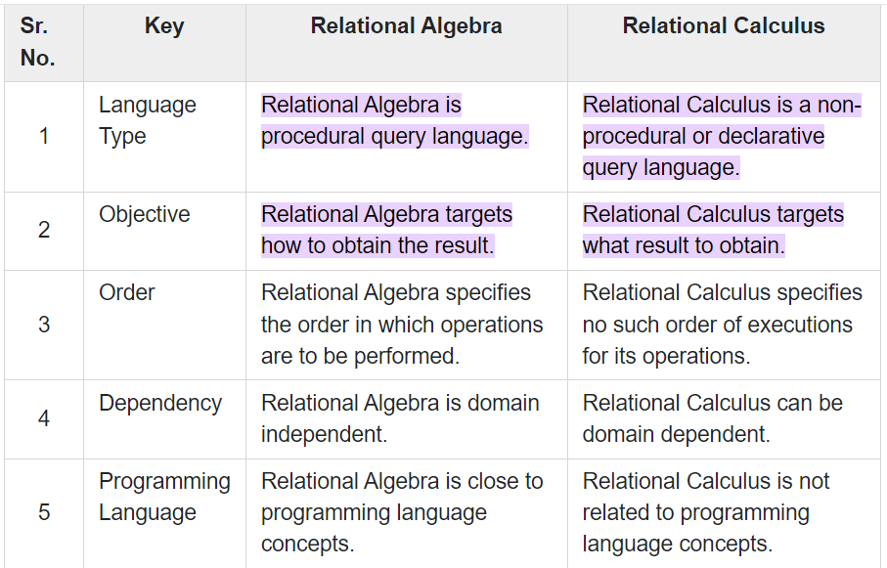
Relational Calculus is said to be a declarative language, in contrast to algebra, which is a procedural language. Explain the distinction.
Relational Algebra is procedural query language. Relational Calculus is a non-procedural or declarative query language. Relational Algebra targets how to obtain the result. Relational Calculus targets what result to obtain.

Slide 4
Tuple Relational Calculus: Discuss about Tuple Relational Calculus in detail.
The tuple relational calculus, by contrast, is a nonprocedural query language. It describes the desired information without giving a specific procedure for obtaining that information.
A query in the tuple relational calculus is expressed as
{t | P(t)}
that is, it is the set of all tuples t such that predicate P is true for t.
where P is a formula. Several tuple variables may appear in a formula.
A tuple variable is said to be a free variable unless it is quantified by a ∃ or ∀.
Thus, in t ∈ loan ∧ ∃ s ∈ customer (t[branch-name] = s[branch-name])
Say that we want to find the branch-name, loan-number, and amount for loans of over $1200:
{t | t ∈ loan ∧ t[amount] > 1200}

Slide 5


Tuple Relational Calculus:
Discuss about Tuple Relational Calculus in detail.
Write the following queries in Tuple Relational Calculus for following Schema.
Sailors (sid: integer, sname: string, rating: integer, age: real)
Boats (bid: integer, bname: string, color: string)
Reserves (sid: integer, bid: integer, day: date)
i. Find the names of sailors who have reserved boat 103
Find the names of sailors who have reserved a red boat

Slide 6

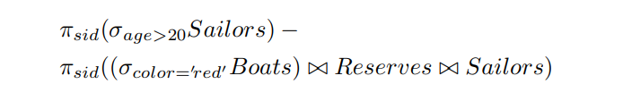

ii. Find the names of sailors who have reserved at least one boat
iii. Find the sids of sailors with age over 20 who have not reserved a red boat.
iv. Find the names of sailors who have reserved all boats.

Slide 7
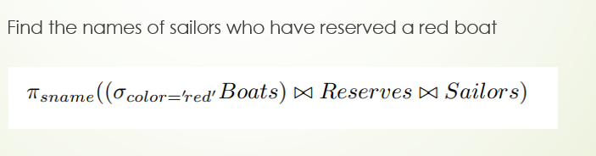
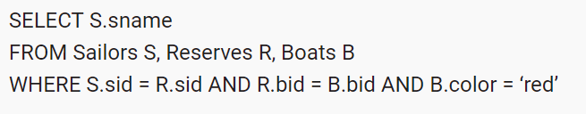
Equivalent SQL Query:
Equivalent SQL Query:

Slide 8
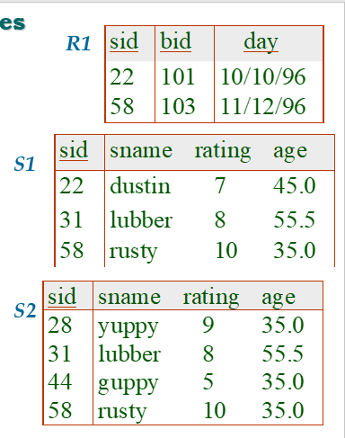
Explain various operations in relational algebra with example.
Basic operations:
Selection ( ) Selects a subset of rows from relation.
Projection ( ) Deletes unwanted columns from relation.
Cross-product ( ) Allows us to combine two relations.
Set-difference ( ) Tuples in reln. 1, but not in reln. 2.
Union ( ) Tuples in reln. 1 and in reln. 2.
Additional operations:
Intersection, join, division, renaming: Not essential, but (very!) useful.

Slide 9
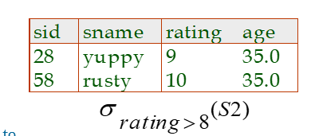
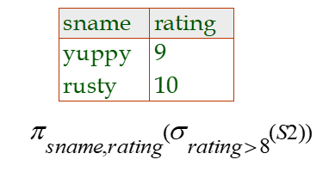
Selection:
Selects rows that satisfy selection condition.

Slide 10
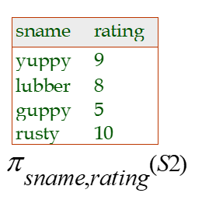
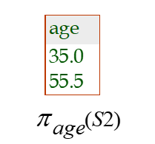
Projection:
Deletes attributes that are not in projection list.
Schema of result contains exactly the fields in the projection list, with the same names that they had in the (only) input relation.
Examples:

Slide 11
Union, Intersection, Set-Difference
All of these operations take two input relations, which must be union-compatible:
Same number of fields.
`Corresponding’ fields have the same type.
What is the schema of result?
Notes:
9

Slide 12
Compare procedural and non procedural DML’s.
Procedural DML
Procedural DMLs (Data Manipulation Language) are a type of programming language that allows users to specify a series of actions to be taken on a database. These actions are often executed in a specific order, or “procedure,” hence the name.
It is a type of DML where we specify what data we want and how we get it.
A procedural language is difficult to learn.
Difficult to debug.
Requires a large number of procedural instructions.
Generally, it is used by professional programmers.
File-oriented concept based.

Slide 13
NON Procedural DML:
NON Procedural DML:
Non-procedural DMLs, on the other hand, do not require users to specify a specific series of actions to be taken on a database. Instead, they allow users to specify the desired result of a query, and the database system itself is responsible for determining the most efficient way to achieve that result.
Examples of non-procedural DMLs include SQL and QBE (Query By Example).
This type of DML specifies only what data we want, no need to mention how to get it.
Easy to learn
This language only requires a few non-procedural instructions.
It can be used by both professional programmers and non-technical users.
Database-oriented concept used in it.

Slide 14
Explain about Relation Completeness
Relational completeness means that a query language can express every query that can be written in relational algebra. It does not mean that the language can express any given query (for example, aggregation, recursion, etc.).
Any relational language as powerful as relational algebra is called relationally complete. A relationally complete language can perform all basic, meaningful operations on relations. Since SQL is a superset of relational algebra, it is also relationally complete.ven query (for example, aggregation, recursion, etc.).

Slide 15
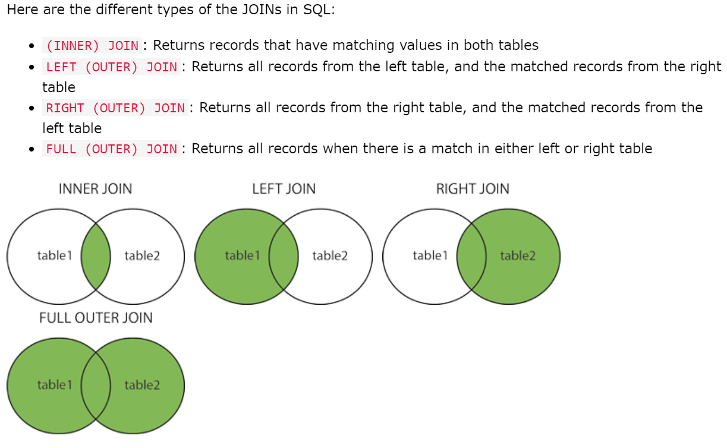
JOINS:

Slide 16
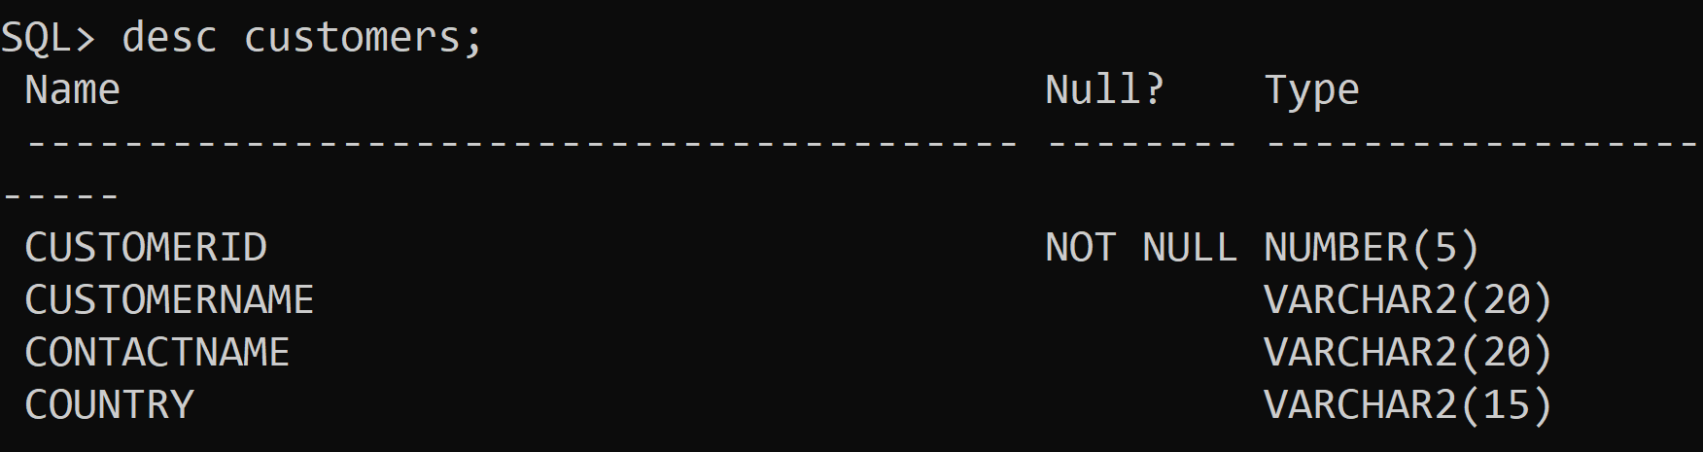
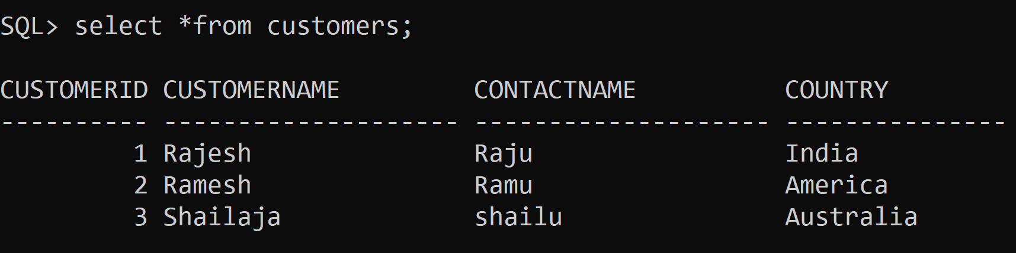
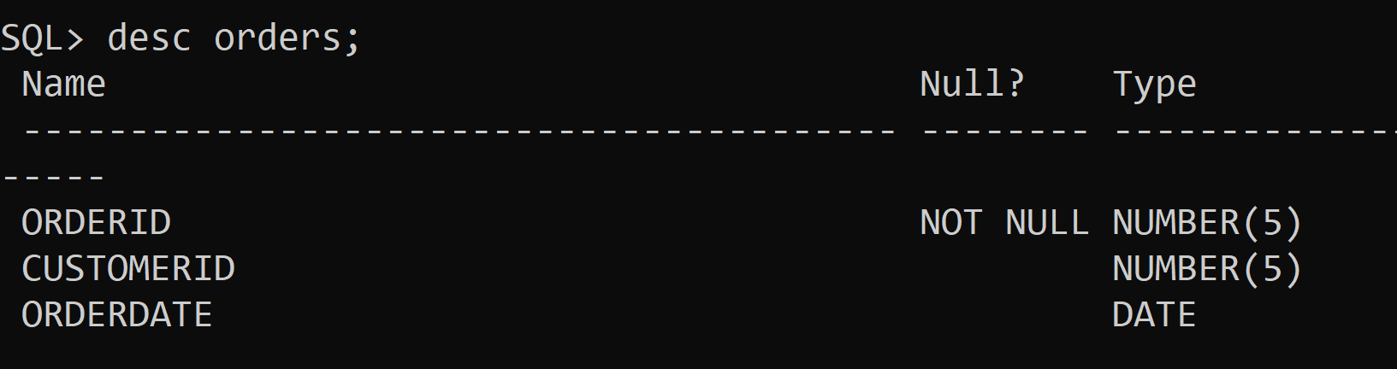
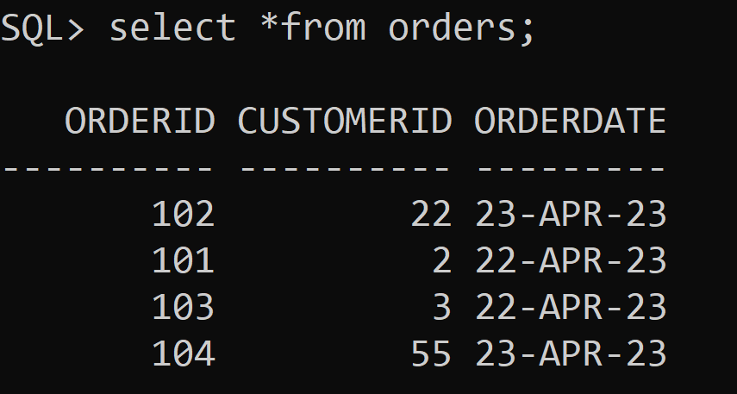
. Explain in detail the following: Join Operations
Join Operation:

Slide 17
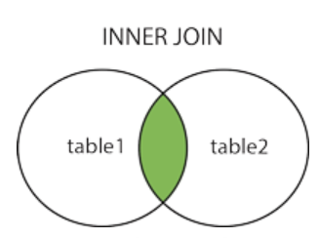
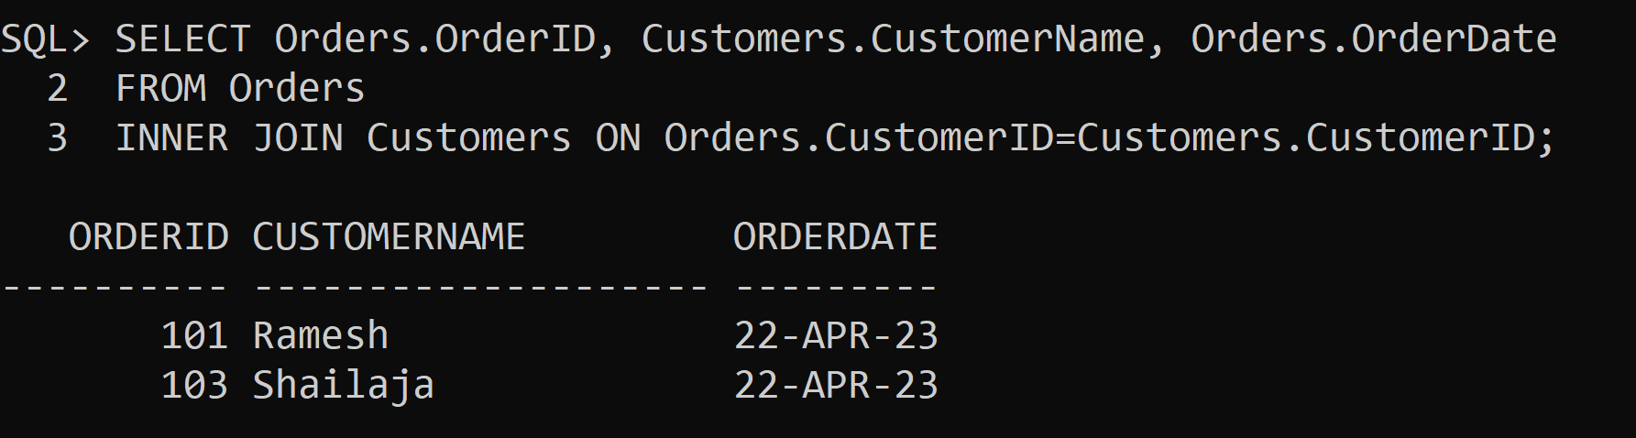
Inner Join:

Slide 18

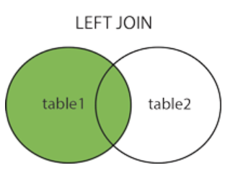
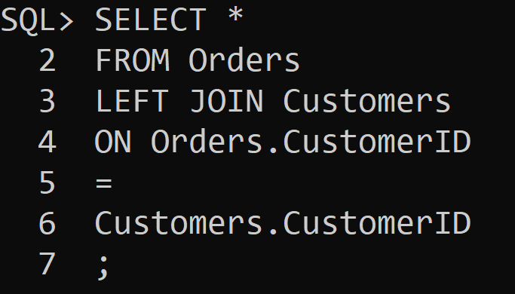
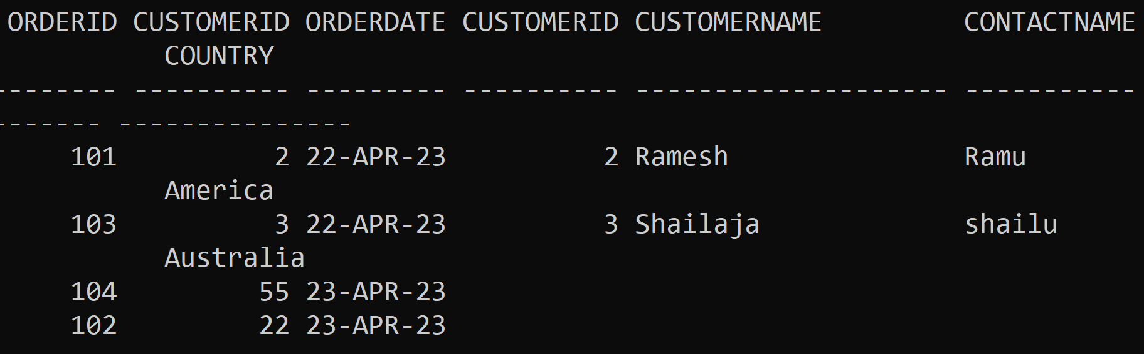
LEFT JOIN:

Slide 19

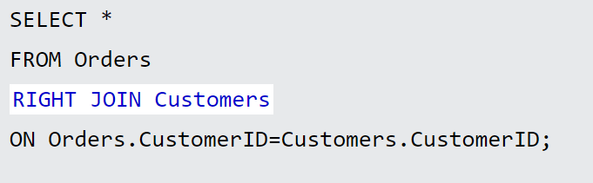
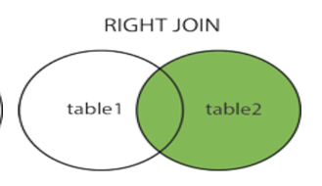
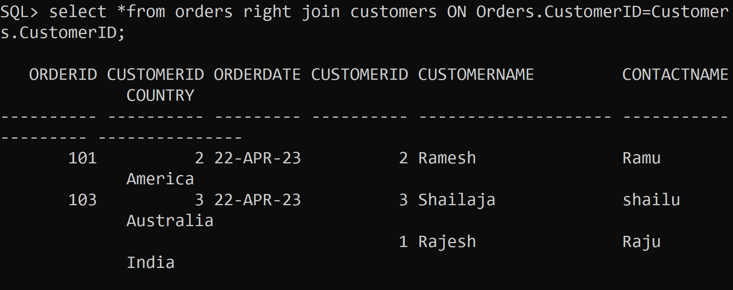
Right JOIN:

Slide 20

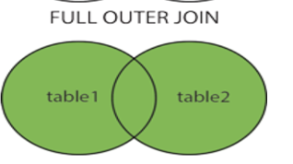
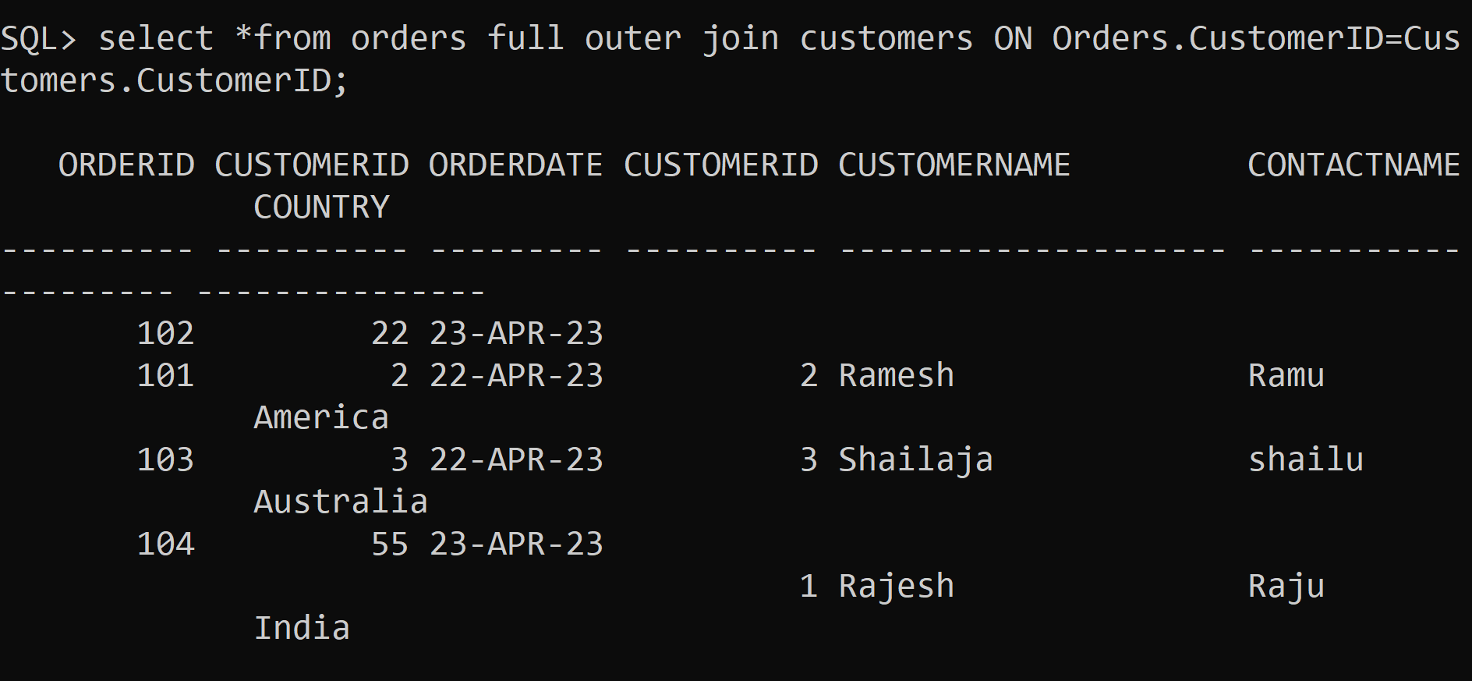
Full outer Join:

Slide 21
SQL : VIEWS
What is a view in SQL?
In SQL, a view is a virtual table based on the result-set of an SQL statement.
A view contains rows and columns, just like a real table. The fields in a view are fields from one or more real tables in the database.
You can add SQL statements and functions to a view and present the data as if the data were coming from one single table.

Slide 22
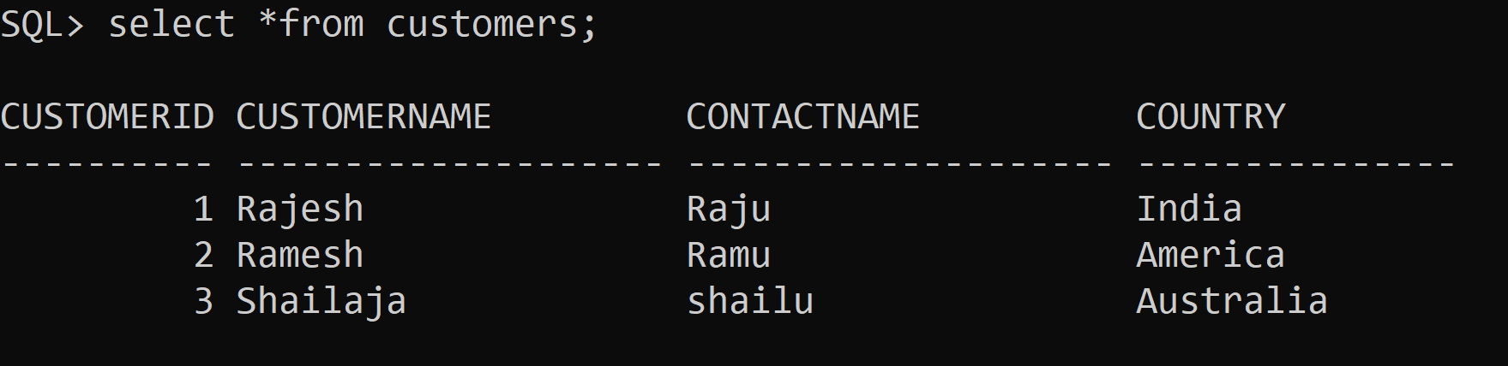
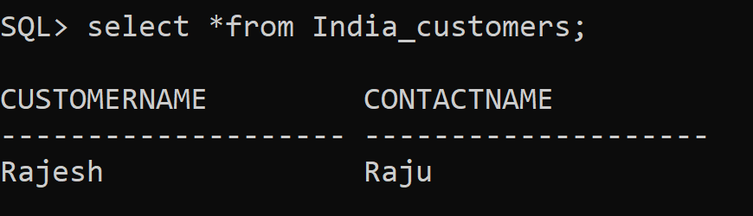
Syntax to create a View:
CREATE VIEW view_name AS SELECT column1, column2, ... FROM table_name WHERE condition;
Example:
create view India_customers as select customername, contactname from customers where country='India';

Slide 23
Another Example:
CREATE VIEW Avg_price AS SELECT ProductName, Price FROM Products WHERE Price > (SELECT AVG(Price) FROM Products);

Slide 24
SQL Updating a View
A view can be updated with the CREATE OR REPLACE VIEW statement.
CREATE OR REPLACE VIEW India_customers AS SELECT CustomerName, ContactName, City FROM Customers WHERE Country = ’India';

Slide 25
SQL Dropping a View
A view is deleted with the DROP VIEW statement.
Syntax:
DROP VIEW view_name;
Example:
DROP VIEW India_customers;

Slide 26
Dealing with NULL Values:
The IS NULL Operator
The IS NULL operator is used to test for empty values (NULL values).
Example:
SELECT CustomerName, ContactName, Address FROM Customers WHERE Address IS NULL;
The IS NOT NULL Operator
The IS NOT NULL operator is used to test for non-empty values (NOT NULL values).
SELECT CustomerName, ContactName, Address FROM Customers WHERE Address IS NOT NULL;

Slide 27
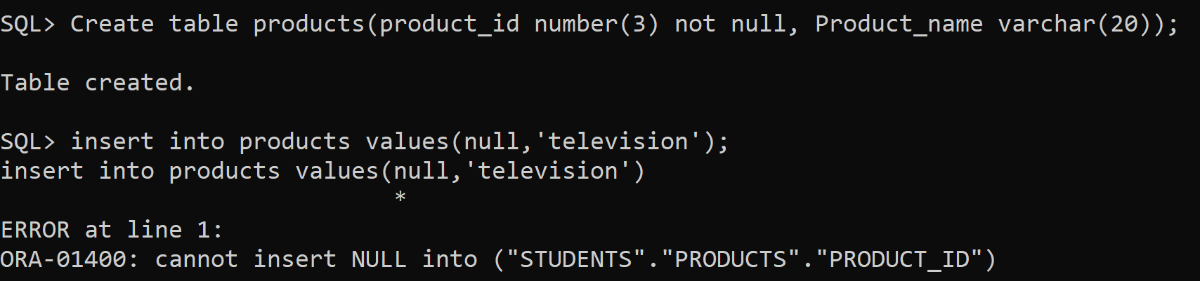
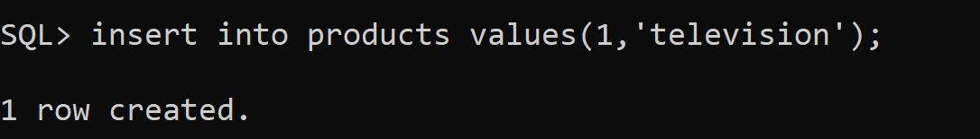
Disallowing NULL values:
To disallow NULL values in any of the columns, add NOT NULL to the definition of each one.

Slide 28
Correlated Nested Queries:
A correlated subquery in MySQL is a subquery that depends on the outer query. It uses the data from the outer query or contains a reference to a parent query that also appears in the outer query. MySQL evaluates it once from each row in the outer query.
Example:
SELECT emp_name, city, income
FROM employees emp WHERE income > (
SELECT AVG(income) FROM employees WHERE city = emp.city);
In the above query, we select an employee name and city whose income is higher than the average income of all employees in each city.

